Slide 1


Record linkage
Searching for matching accommodation solution between Booking and Agoda websites
Sofia Ruggeri 1921870
Data Cleaning and Integration in Official Statistics
Master Degree in Statistical Methods and Applications
Università degli Studi La Sapienza

Slide 2
Table of contents:
Introduction and theoretical overview
Data acquisition and Dataset overview
Pre-elaboration phase
  Key variable selection
  Data cleaning
  Blocking
Record linkage
  name
  Name + city
  Name + city + address
  other
Analysis of results
Statistics
Record linkage
Pagina <number>

Slide 3
Theoretical overview
Problem in data integration: identification of records in two (or more) data sets that correspond to the same entity
In each data file, records are identified by key (or matching) variables, containing common identifying information
Goal of record linkage: detect the pairs (a,b) corresponding to the same entity
The set of all pairs of records AxB can be partitioned into: M (set of matches) and U (set of unmatches)
Record linkage
Pagina <number>

Slide 4
Data acquisition method
The dataset that will be used to apply the record linkage contains data on accommodation solutions (hotels, apartments, b&bs, villas) for a one-night (August 1st - August 2nd) stay in Rome and Terni.
Data were not found online, but they were collected directly from two sites: Agoda and Booking, with the technique of web scraping.
It consists in automatically collecting data from websites by using scripts that navigate pages and extract relevant information from the HTML structure of the site.
The structure of the obtained dataset is a little bit different between the two sites, but they have some common variables: name, city, address, price, reviews of customers and rating.
GOAL: Apply record linkage in order to find which are the accommodation solutions in common between the two sites (same entities) and then make some analysis and comparison on the price.
Record linkage
Pagina <number>

Slide 5
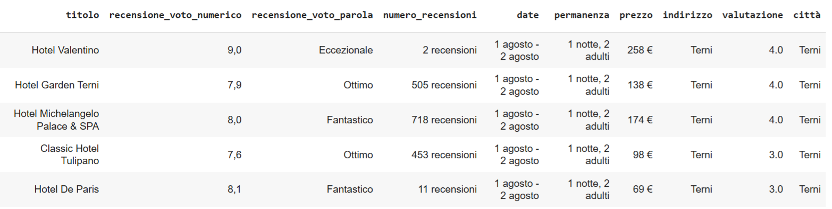
Dataset overview: Agoda
Record linkage
Pagina <number>

Slide 6
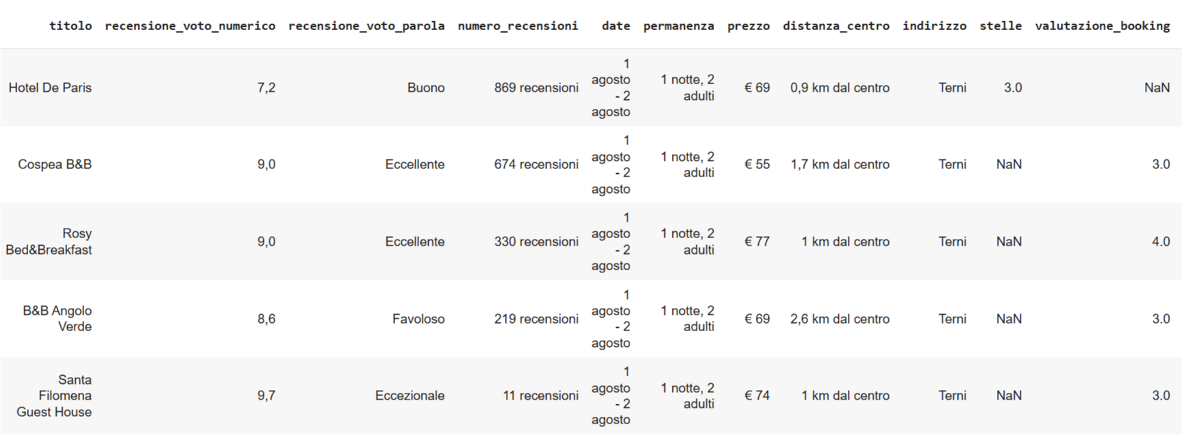
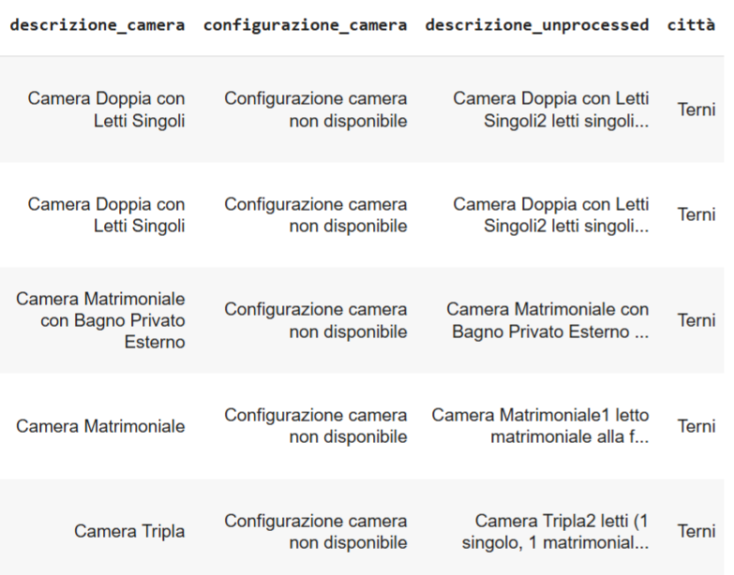
Dataset overview: Booking
Record linkage
Pagina <number>

Slide 7
Pre-elaboration phase:
1) Key variable selection
2) Data cleaning
3) Blocking
Key variables selection phase is crucial to obtain a correct linkage.
They need to be compatible and homogeneous within the two data sources, the following properties are required:
Universality (observable for all units)
Accuracy (few errors)
Stability (not subject to big changes over time)
Non sensibility (privacy protected)
As a first try it will be considered three key (matching) variables: name, city and address.
They will be added in different steps, to see how the linkage performs with the addiction of another key variable.
Other information like the price or the rating are not a safe choice as key variables because they can be different within the two data sources.
Errors in variables is related to data quality, that leads to the second phase (data cleaning).
Record linkage
Pagina <number>

Slide 8
Pre-elaboration phase:
1) Key variable selection
2) Data cleaning
3) Blocking
In this phase the quality of data is improved.
Creation of dataset (smaller) with only variables of interest for the analysis
All the variables must be converted to a standard form (compatible between the two data sources in order to be compared)
  Same format
  All lower case
  No commas
  No common names in ‘address’ (piazza, via, e, rione, fontana, città, di, del)
Were artificially inserted some record with typos to see how the model performs (it should work well in these scenarios frequent in real life)
Record linkage
Pagina <number>

Slide 9
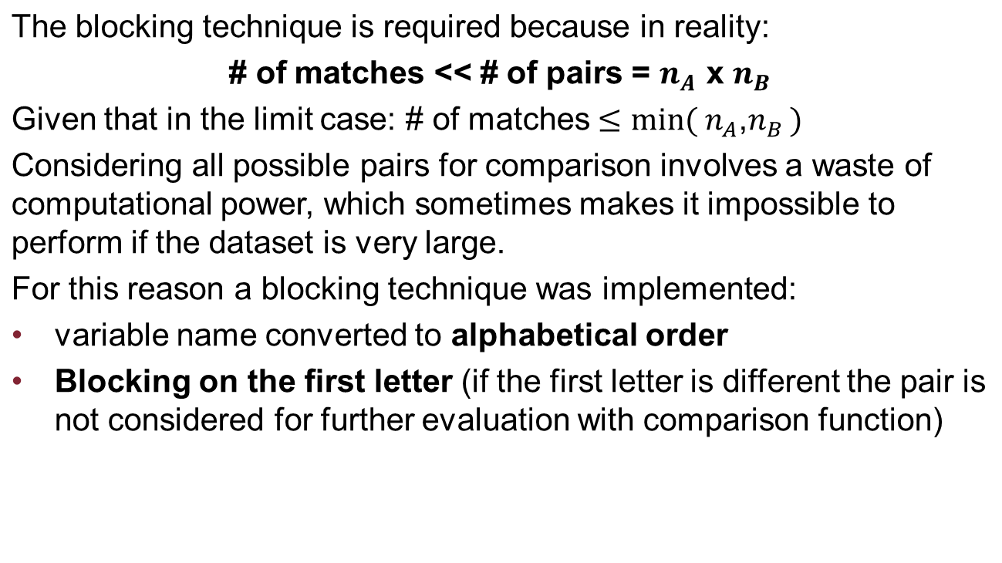
Pre-elaboration phase:
1) Key variable selection
2) Data cleaning
3) Blocking
Record linkage
Pagina <number>

Slide 10
Record linkage on name
In this first step it was considered just the name as matching variable.
Record linkage was implemented on Python using the package ‘recordlinkage’
It was implemented the probabilistic linkage Fellegi-Sunter
The comparison function is based on the jarowinkler distance, since the variable name is composed by several strings.
The package required to insert a threshold to feed a binary input to the algorithm and for the name it was decided to set it equal to 0.95.
0/1 comparison function
Record linkage
Pagina <number>

Slide 11
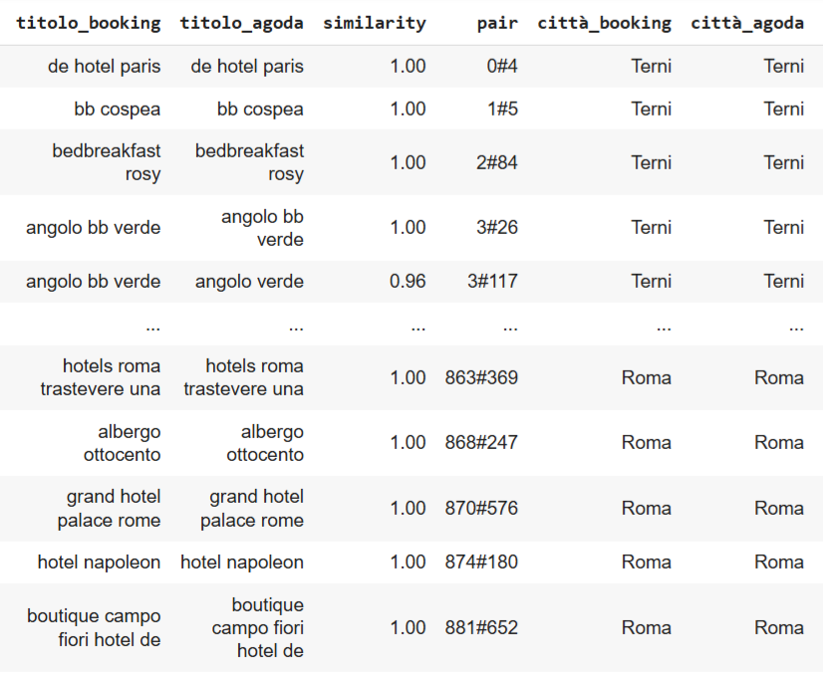
Results
The number of candidate pairs are 64329
Total number of matches is 290
It is possible to see the level of similarity for each pair
The results seem to be quite good but there are still some errors
After trying different value of the parameter it was decided to set it equal to 0.955.
Record linkage
Pagina <number>

Slide 12
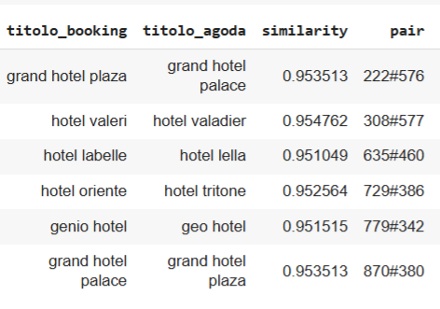
Higher threshold: 0.955
On the left the record removed after considering an higher threshold
The model classifies better, while still being able to recognise typos, titles in different order.
Considering just one variable the model is basically deterministic and too simple
The Fellegi-Sunter does not add much, it basically returns the same decision as deterministic
Too low complexity
To asses this point let’s add complexity and try to consider also the city as matching variable.
Record linkage
Pagina <number>

Slide 13
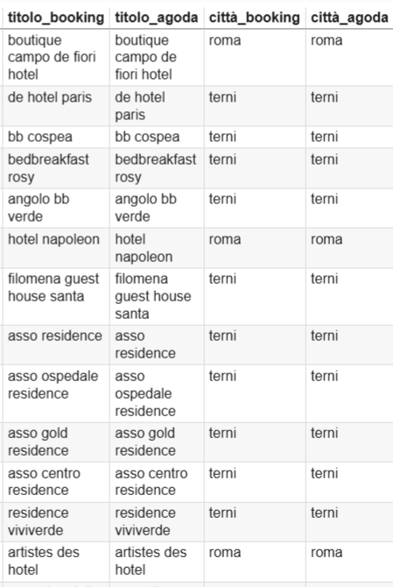
Record linkage on name + city
The necessity to consider jointly name and city comes from the fact that two records may have the same name but being located in different cities.
The threshold used are now:
  For the name 0.95
  For the city variable equal to 0.80
  The total number of match now is equal to 275.
But let’s see all the record that were successfully removed considering both name and city.
Record linkage
Pagina <number>

Slide 14
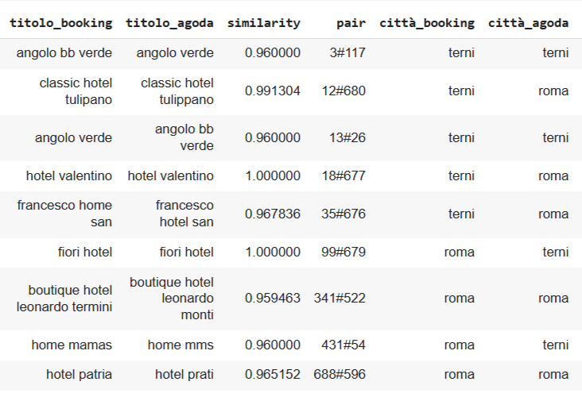
Results of addiction of key variable city
The record below are all the records that were classified as match at the previous stage and unmatch now.
It is more visible now the contribute of the probabilistic model Fellegi-Sunter
  in this step were discarded record with same or similar name located in different cities
  but also record in the same city that were indeed different entities (like angolo bb verde/ angolo verde, patria/prati, boutique hotel Leonardo monti/termini) that before were incorrectly matched.
  Now the model works better, performs better than deterministic one.
It was inserted a typo (‘tulipano’, ‘tulippano’ and it was matched correctly at the previous stage)
It can happen in large cities that a company has hotels in various areas of the city, so it could be useful to consider also the address.
Record linkage
Pagina <number>

Slide 15
Record linkage on name + city + address
As mentioned before, several adjustments have been made to the address variable to make it as manageable and recognizable as possible for the model.
It is still hard for the model to use because in a lot of cases it matches, but sometimes it may happen that the same area is specified differently in the two platforms (for example: Colosseo/monti)
There are also several missing values
For these reason it was decided to consider a least restrictive threshold (like 0.6)
The resulting number of match was exactly the same as the case with name and city.
Record linkage
Pagina <number>

Slide 16
Low and medium threshold
Several number of thresholds were tried and both high and low threshold returned wrong results.
If it’s 0.30 there are 323 matches
If the threshold is too low there will be a lot of 1 in the comparison vector and it will end up with wrong linkage (false positive).
If the threshold is set to a medium value like 0.4-0.6 there are 275 matches
It is the exact same result of considering just name and city
So address just add noise, is not useful for the matching
Record linkage
Pagina <number>

Slide 17
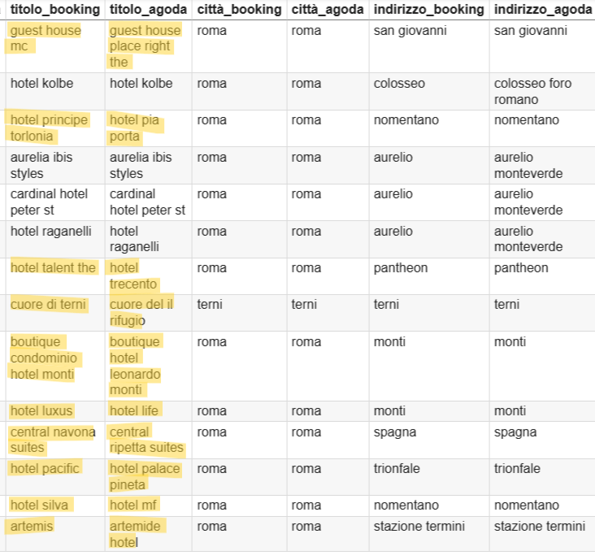
High threshold
If the threshold is too high, this is a little more counterintuitive, there will be a lot of matches, even if it may seem more rigid.
If it’s 0.9 there are 383 matches (worst case)
If the threshold is too high just a few record will have ‘1’ value
What happen is that if the variable is not robust, or there are a lot of places with the same address, the algorithm will prioritize the address as match over the name.
The wrong matches in the table have same address, same city and a quite ‘similar’ name (<0.95)
Record linkage
Pagina <number>

Slide 18
Final considerations
It was tried to consider other variables like price and rating, because they are supposed to be similar between sites.
The result was 275 matches and exactly the same obtained with name and city.
The name and city are enough as identifiers in this case of application.
It was tried to consider also just the other variables (city, address, number of reviews, rating, price) without name and use it as ground truth (using jarowrinkler at 0.955)
The result was 76 true match over 290.
The other variables are not enough, they have not the required characteristics for a key variable, as said at the beginning.
Results improved taking the logarithm of the price and of the number of reviews.
Record linkage
Pagina <number>

Slide 19
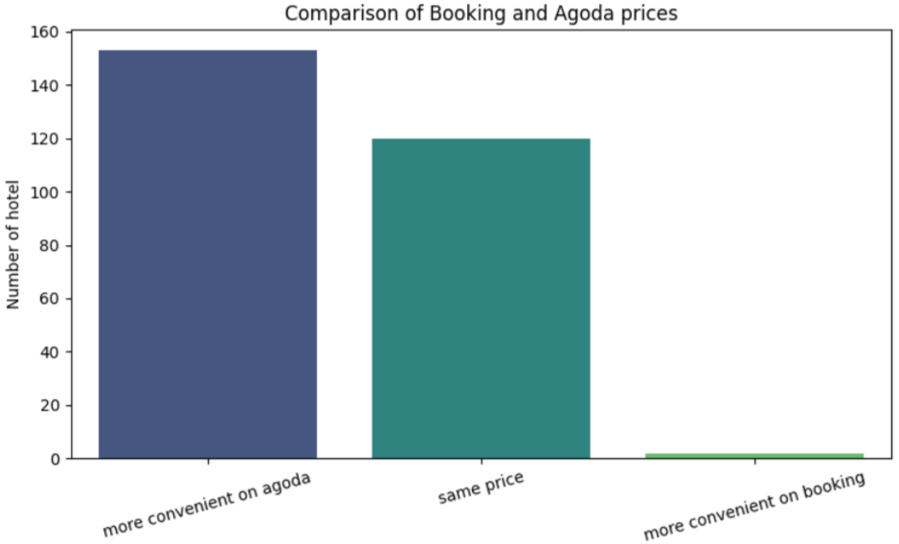
Statistics on the price
Now it is possible to make some statistics and comparisons between the prices from the two platforms.
There are a considerable number of times where agoda and booking offer the same price
But the majority of times agoda offers the same accommodation for a lower price.
Agoda costs on average 22.84 € less.
The average percentage difference is -10.29%.
Record linkage
Pagina <number>

Slide 20
Terni vs Roma
It’s interesting to see some statistics considering separately with respect to the two cities
The following table shows the medium cost for a night in Rome and in Terni, for the same day.
As we can see Rome is much more expensive than Terni
It is possible that in Rome there are some accommodation that cost much more than the average, so they can be considered outliers.
Let’s check this point
City | Price Agoda (€) | Price Booking (€)
Roma | 193.77 | 223.46
Terni | 99.04 | 99.32
Record linkage
Pagina <number>

Slide 21
Outliers
Title | Price Agoda (€) | Price Booking (€)
boutique campo de fiori hotel | 470 | 499
astoria cavalieri hotel waldorf | 1620 | 1620
fontana room trevi | 358 | 384
pantheon relais terrace | 366 | 366
ludus rooms | 412 | 414
grand hotel plaza | 345 | 376
hotel viminale | 367 | 386
glori hotel villa | 752 | 802
atlante hotel star | 345 | 410
hotel locarno | 500 | 599
paolo residenza vi | 427 | 502
21 domus luxury suites | 338 | 421
barberini hotel | 359 | 364
barocco hotel | 349 | 349
inn luxury palace trevi | 266 | 416
Outliers where identified with the technique of the boxplot and the interquartile range
There were classified 15 places as outlier
Let’s try to remove them and see if how much the medium price changes by removing these outliers.
Record linkage

Slide 22
Outliers removed
City | Price Agoda (€) | Price Booking (€)
Rome | 171.49 | 200.21
Terni | 99.04 | 99.32
Once these just 15 hotels were removed, the average cost for a night in Rome has decreased of 22 euros for Agoda and 23 euros for booking
Record linkage
Pagina <number>

Slide 23
Thank you for your attention
Record linkage
Pagina <number>

